Slide 1
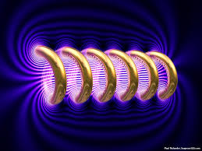
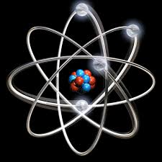

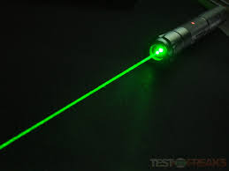


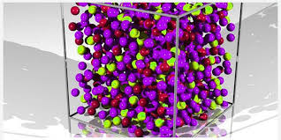
Engineering Physics
L-5
(Electromagnetic Theory)
ELECTROMAGNETIC THEORY
QUANTUM MECHANICS
LASER
WAVES
Dr. Mukesh Kumar
Lovely Professional University
Phagwara, Punjab-144411
SOLID STATE PHYSICS
FIBRE OPTICS

Slide 2
EMT-Topics
Scalar and Vector fields.
Concepts of gradient, divergence and curl.
Gauss Theorem and Stokes theorem.
Poisson and Laplace’s Equation.
Continuity equation.
Maxwell’s Electromagnetic equation.
Physical significance of Maxwell’s equation.
Ampere’s Circuital law.
Maxwell displacement current and correction in Amperes law.

Slide 3
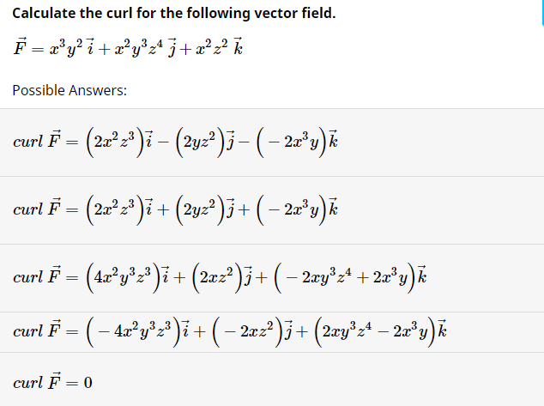

Slide 4

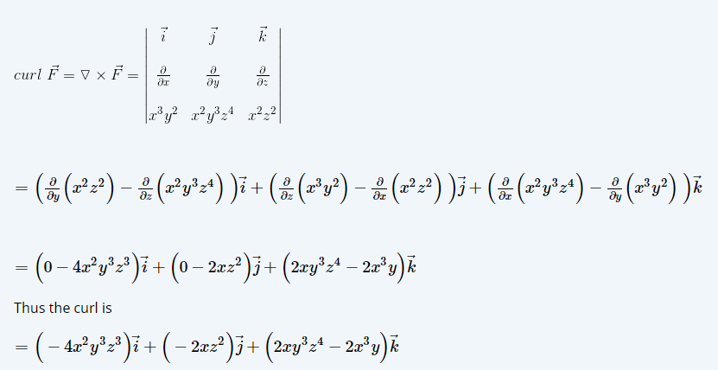

Slide 5

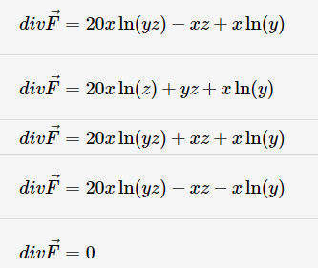

Slide 6

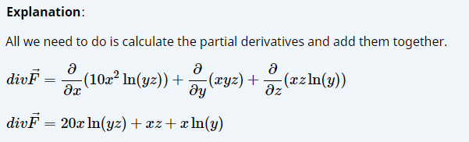

Slide 7
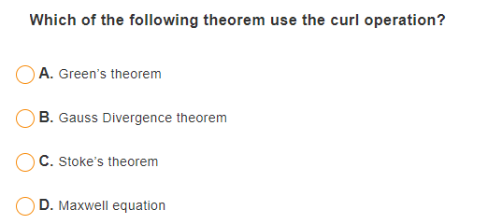

Slide 8
Displacement Current:
Characteristics of displacement current:
It has the same unit as electric current density.
Displacement current is a current only in the sense that it produces magnetic field. It has none other properties of current. For example displacement current can have a finite value in vacuum where there are no charges of any type.
It serves to make the total current continuous across discontinuities in conduction current.
It makes the Ampere’s circuital law a consistent one.
Maxwell came up with this rather curious name because many of his ideas regarding electric and magnetic fields were completely wrong. For instance, Maxwell believed in the æther, and he thought that electric and magnetic fields were some sort of stresses in this medium. He also thought that the displacement current was associated with displacements of the æther (hence, the name).
The reason that these misconceptions did not invalidate his equations is quite simple. Maxwell based his equations on the results of experiments, and he added in his extra term so as to make these equations mathematically self-consistent. Both of these steps are valid irrespective of the existence or non-existence of the æther.
http://farside.ph.utexas.edu/teaching/em/lectures/node46.html

Slide 9
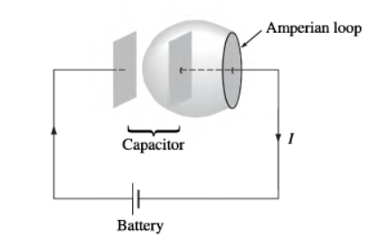
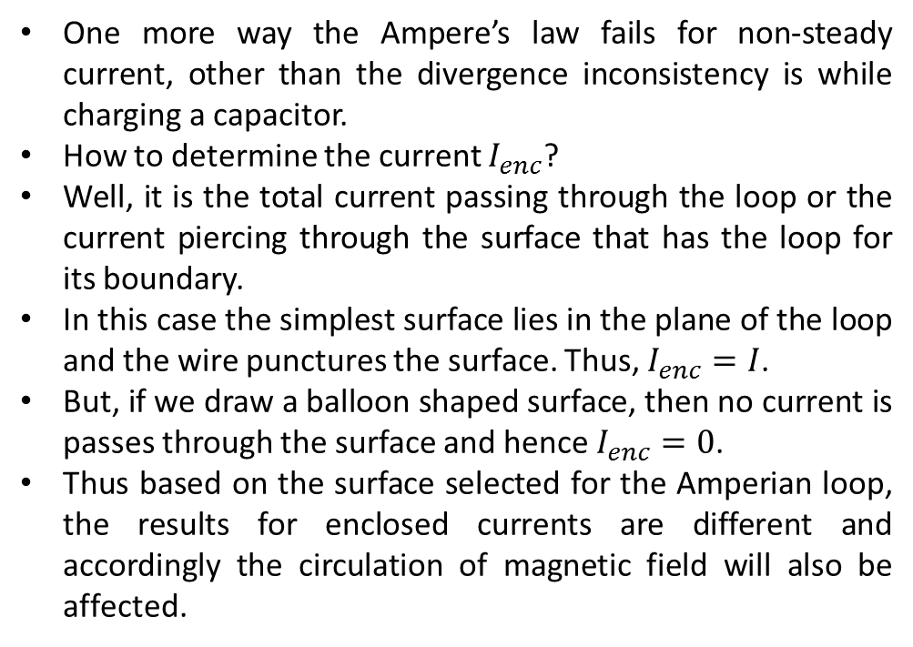
Displacement Current: Capacitor example
How can you say that for steady current, the divergence inconsistency is removed?
One more way the Ampere’s law fails for non-steady current, other than the divergence inconsistency is while charging a capacitor.
How to determine the current $I_{enc}$?
Well, it is the total current passing through the loop or the current piercing through the surface that has the loop for its boundary.
In this case the simplest surface lies in the plane of the loop and the wire punctures the surface. Thus, $I_{enc}=I$.
But, if we draw a balloon shaped surface, then no current is passes through the surface and hence $I_{enc}=0$.
Thus based on the surface selected for the Amperian loop, the results for enclosed currents are different and accordingly the circulation of magnetic field will also be affected.

Slide 10
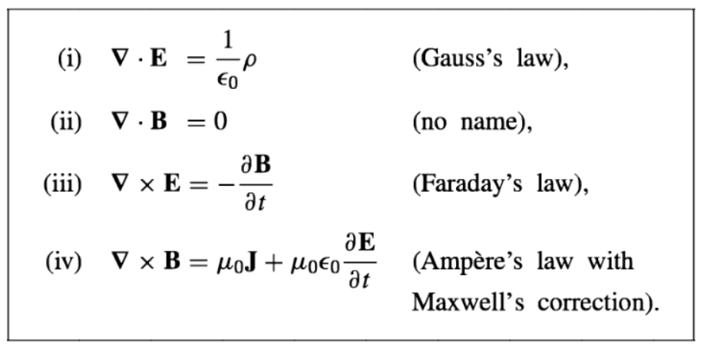
Maxwell’s Equation: Differential Form
Some people call this as Gauss law
in magneto statics.

Slide 11
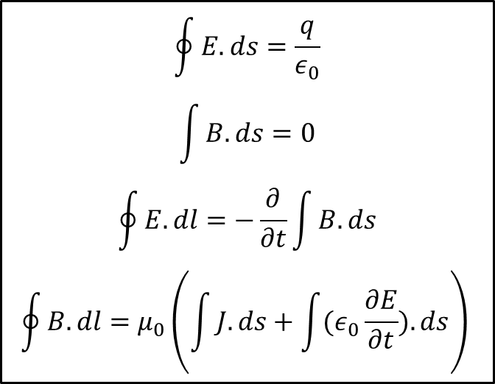
Maxwell’s Equation: Integral Form
$$\oint{E.ds=\frac{q}{ε_{0}}}$$
$$\int{B.ds=0}$$
$$\oint{E.dl}=−\frac{∂}{∂t}\int{B.ds}$$
$$\oint{B.dl=μ_{0}\left(\int{J.ds}+\int{(ε_{0}\frac{∂E}{∂t}}).ds\right) }$$

Slide 12
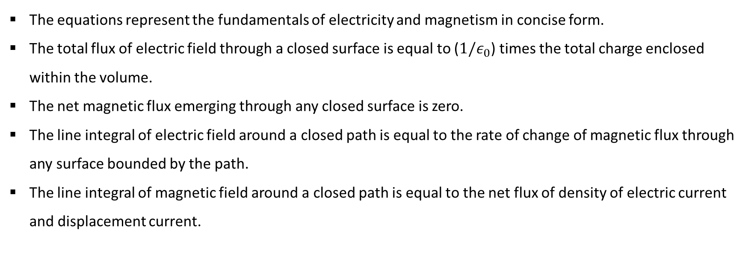
Physical Significance of Maxwell’s Equation
The equations represent the fundamentals of electricity and magnetism in concise form.
The total flux of electric field through a closed surface is equal to ($1/ε_{0}$) times the total charge enclosed within the volume.
The net magnetic flux emerging through any closed surface is zero.
The line integral of electric field around a closed path is equal to the rate of change of magnetic flux through any surface bounded by the path.
The line integral of magnetic field around a closed path is equal to the net flux of density of electric current and displacement current.

Slide 13
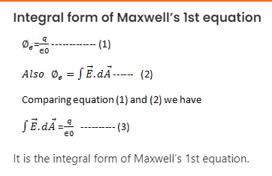

Slide 14
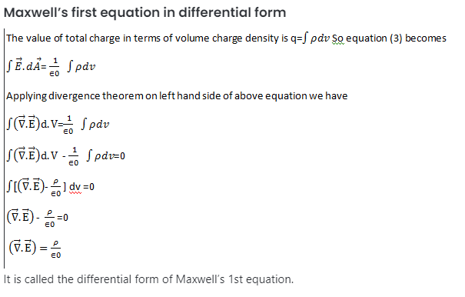

Slide 15
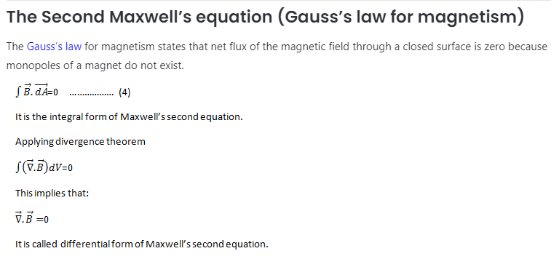

Slide 16
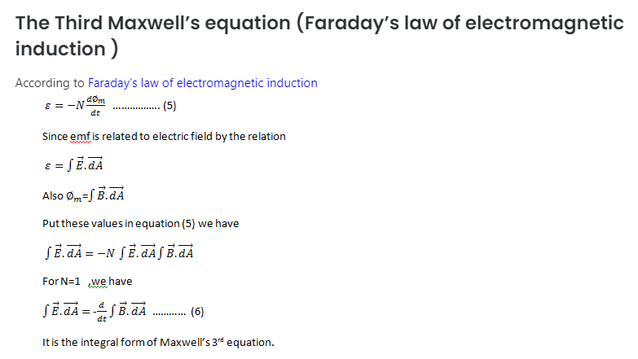

Slide 17
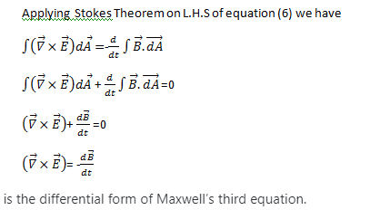

Slide 18
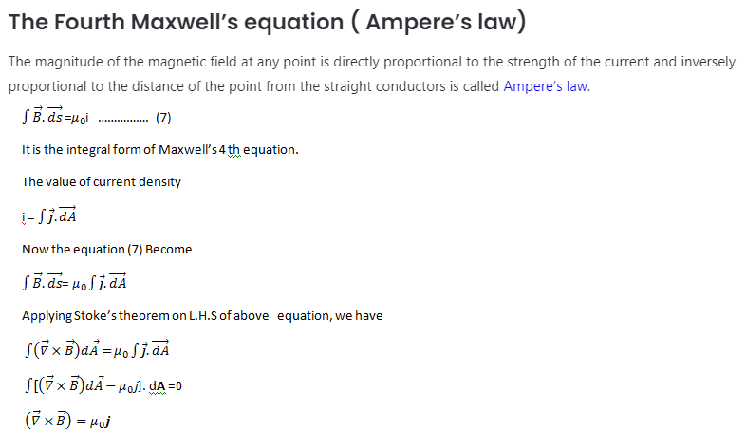

Slide 19
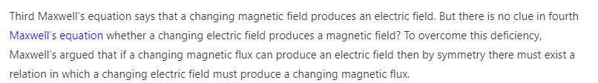

Slide 20
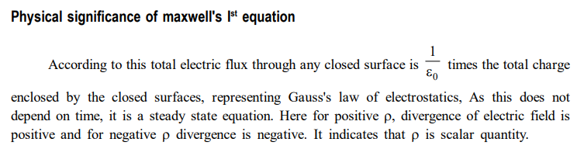

Slide 21
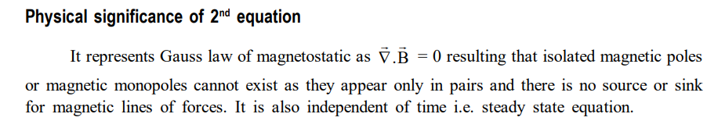

Slide 22
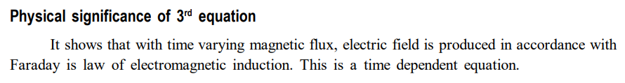

Slide 23
